Slide 1
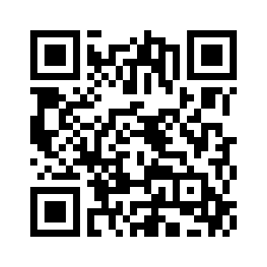
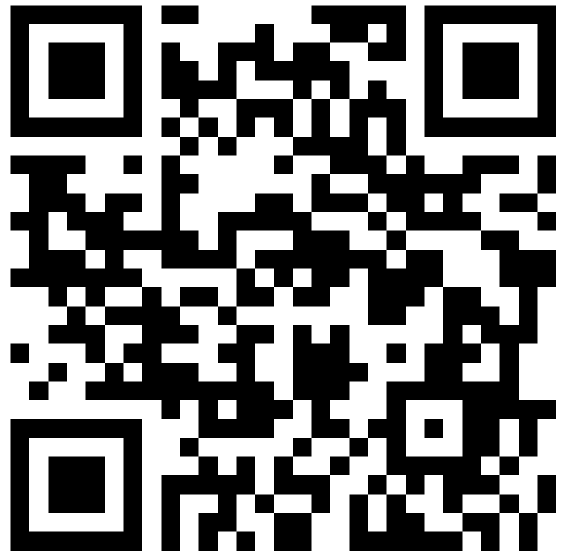
Experimental Robotics
COMSM4111 Robotic Systems
Anonymous Feedback form:
https://forms.gle/PyQQy2mwzyATFmJW6
Padlet board (questions & comments):
http://padlet.com/paul_odowd1/1lhoodwv2fuc
Delivered by:
Paul O’Dowd paul.odowd@bristol.ac.uk

Slide 2
House Keeping
This Wednesday: Bill Brown is not free between 11am 1pm.
Close Group Declaration thread at 6pm Thursday 14th November.
Submit a formative experiment proposal beginning Wednesday 20th November, feedback by Friday 29th November.

Slide 3
Lab Sessions / Sheets
Week 1
Week 2
Week 3
Week 4
Week 5
Week 6
Week 7
Meet the Romi
Millis()
Encoders
PID
Line Following
Finite State Machine
Motors
Time & Speed
Kinematics
Lectures
Intro
Sensors & Actuators
Feedback Control 2
Probabilistic Robotics
System
Architectures
Path Planning
Experimental Robotics
Micro-controllers
Feedback Control 1
Kinematics
PID Drop-In
Sensor Fusion
Searching & Mapping
Assessment 2 Briefing
Toward
Assessment 2
Assessment Op 1
Assessment Op 2
Assessment Op 3

Slide 4
Lab Sessions / Sheets
Reading Week
Week 8
Week 7
Week 9
Week 10
Week 11
Week 12
2 Hour Drop-in
2 Hour Drop-in
2 Hour Drop-in
2 Hour Drop-in
Lectures
Experimental Robotics
1 Hour Drop-in
1 Hour Drop-in
1 Hour Drop-in
Assessment 2 Briefing
1 Hour Drop-in
1 Hour Drop-in
1 Hour Drop-in
Toward
Assessment 2
Assessment Op 3
Formative
Proposal
Submission
Formative Proposal Feedback
(3 Hours) Demo / Feedback
Report Submission

Slide 5
Rationale
Experimental
Method
Key
Implementation
Characteristics
Hypothesis
Experiment 1
Baseline / Control
Experiment 2
(comparison)
(demo)
Area of Improvement
Results, Discussion, Evaluation
Write a Report:
Using mapping performance as a key context/metric

Slide 6
International Conference on Intelligent Robots and Systems (IROS)
Year

Slide 7
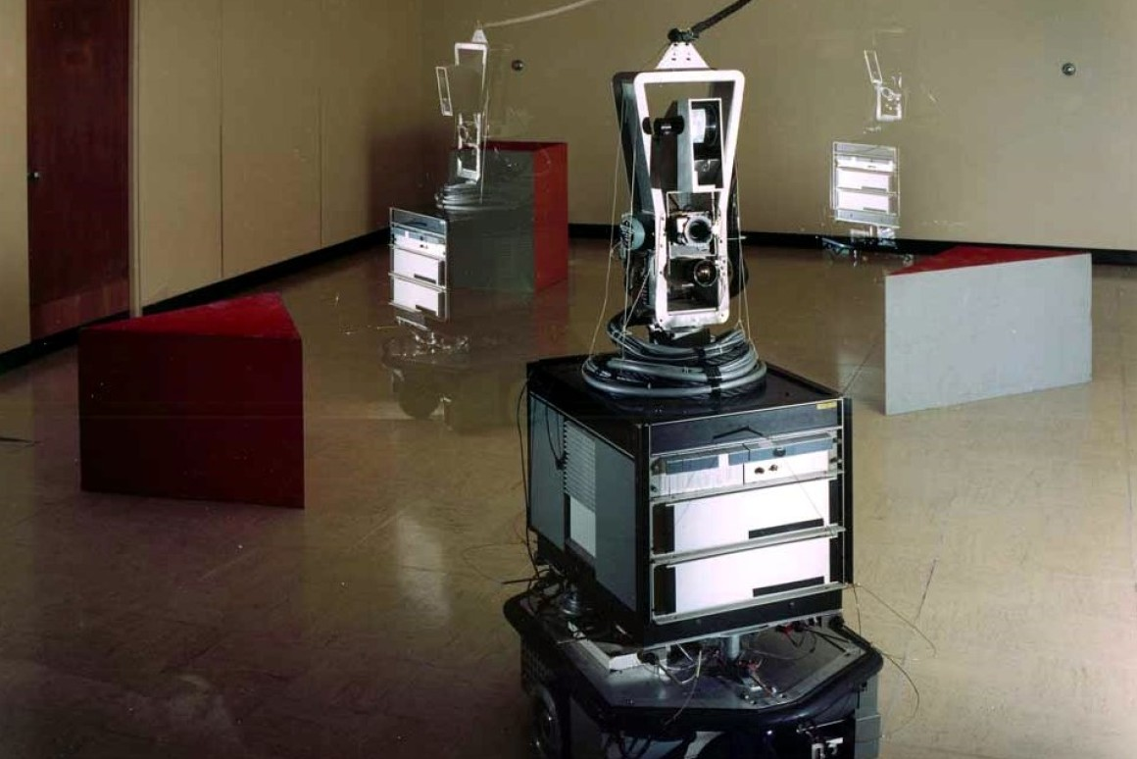
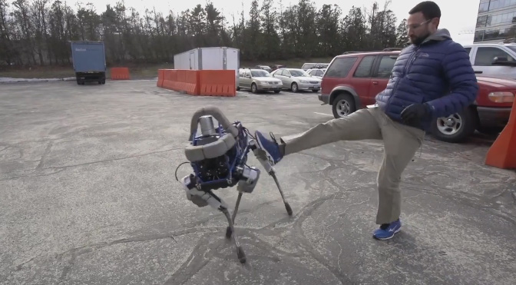
Laboratory
“Real world”
Shakey, 1966
complexity
https://www.youtube.com/user/BostonDynamics/videos

Slide 8
EC FP7:Open Questions for Robotics Research:
How to decompose into components or sub-components?
How to evaluate a complex system?
How to define suitable metrics?
How to reproduce an experiment?
How to impose benchmarking as a scientifically recognised valuable activity?
How to benefit from standards without preventing innovation?
http://www.heronrobots.com/EuronGEMSig/downloads/Zaragoza/RSS2010-Benchmarking-AnneBAJART.pdf
Notes:
2 -> Complicated vs Complex. Complex systems have an high inter-relation, feedback, emergence. Complexity goes up as we get closer to reality.
4 -> Falsifiability, aim to disprove, not to prove. Darren Brown.

Slide 9
Things to aim for: observable, repeatable, and objective
Use good measures, which are standardized and/or usable by others, and are as objective as possible.
Clearly and thoroughly explain the exact methods used to run the study so that others can reproduce the study to see if they get similar or different results.
Minimize subjectivity in experimental observations as much as possible.
http://www.willowgarage.com/sites/default/files/TakayamaRSSworkshop.pdf

Slide 10
Good Experimental Methodology (GEM) Guidelines (2008)
Is it an experimental paper?
Are the system assumptions / hypotheses clear?
Are the evaluation criteria spelled out explicitly?
What is being measured and how?
Is there enough information to reproduce the work?
Do the results obtained give a fair and realistic picture of the system being studied?
Are the drawn conclusions precise and valid?
http://www.heronrobots.com/EuronGEMSig/downloads/GemSigGuidelinesBeta.pdf
Notes:
1) Can present theoretical work, new concepts, technical demonstrators, reviews, etc

Slide 11
A Hypothesis: Situating / Contextualising
What are you trying to do? - no jargon.
How is it done today, and what are the limits of current practice?
What's new in your approach and why do you think it will be successful? [hypothesis]
So what? If you're successful, what difference will it make? What are the risks and the payoffs?
How much will it cost? How long will it take? What are the midterm and final "exams" to check for success?
https://blog.robotiq.com/how-to-design-a-robotics-experiment-in-5-steps

Slide 12
Types of Experiments in Robotics
Object-Centred
Variable Based
Technologies informed by scientific understanding, “systematic technology”.
Common concepts between systems.
Understanding / demonstrating the effect of a generalisable parameter or variable.
Characterising a system, “empirical technology”.
Reveals opportunity and insight regarding technology.
Comparing one technology to another, e.g., algorithm vs algorithm.
http://www.willowgarage.com/sites/default/files/TakayamaRSSworkshop.pdf

Slide 13
Variables: Ceteris Paribus – “all things being equal”
…hold constant all variables that are not of interest.
Independent Variable – The variable be changed through the experiments. Also called ‘manipulated variable’.
Dependent Variable – The variable being observed, effected by the independent variable. Also called ‘responding variable’.

Slide 14
Find & Discuss:
So what? – what is the impact / rationale?
Hypothesis
What is being measured and how? Are suitable metrics defined?
The exact methods used to run the study, is there enough information to reproduce the work?
Dependent / Independent Variables
Object-centred or Variable based?

